Slide 1

Secure Password Generator
In an era of increasing cyber threats, robust password security is paramount. Passwords protect sensitive information across platforms like email, banking, and social media.
Many users struggle to create strong, memorable passwords, often using weak combinations. Password generator applications offer a solution by automating the creation of secure passwords based on specified criteria.

Slide 2
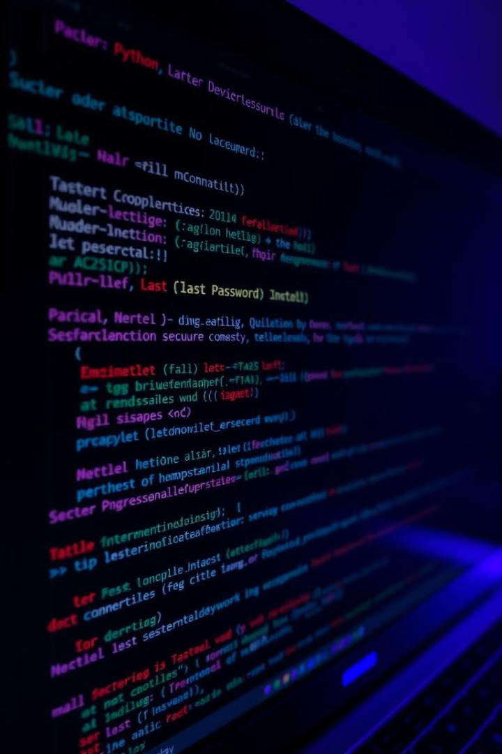
Objectives and Scope
1
Development
Develop a secure password generator application using Python and Tkinter.
2
Features
Implement features to specify the number of passwords needed and their lengths.
3
Security
Ensure generated passwords incorporate a mix of lowercase letters, uppercase letters, and numbers.
4
Interface
Provide a user-friendly graphical interface for ease of use.

Slide 3
Password Security Challenges
Weak Passwords
Password Reuse
Phishing Attacks
Users often create passwords that are easy to remember but lack complexity, making them vulnerable to attacks.
Many individuals use the same password across multiple accounts, increasing vulnerability across different platforms.
Cybercriminals employ phishing techniques to trick users into revealing their passwords, compromising security.

Slide 4

Existing Password Generation Techniques
Random Character Selection
Rule-Based Generation
Some generators apply specific rules (e.g., at least one uppercase letter) to enhance complexity.
Basic password generators randomly select characters from predefined sets (e.g., letters, numbers).
Entropy-Based Methods
These methods assess the randomness of generated passwords based on statistical measures.

Slide 5
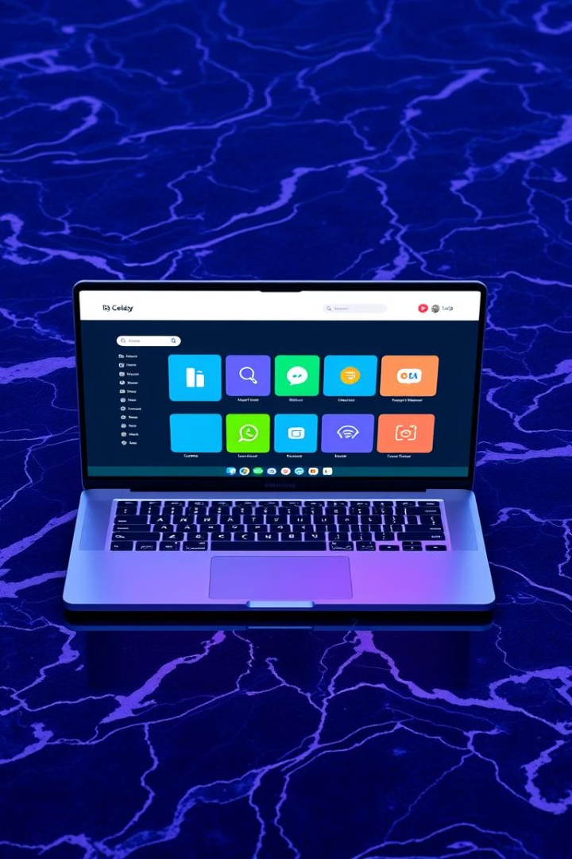

GUI Framework used in Python
Tkinter
A built-in library that provides a simple way to create GUIs in Python, chosen for its simplicity and ease of use.

Slide 6
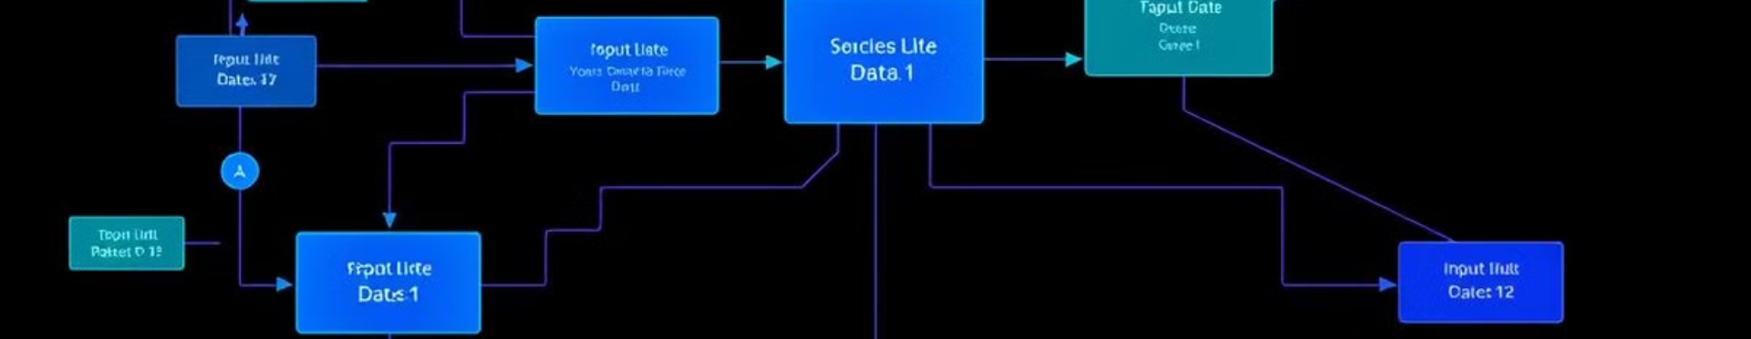



System Architecture
Input Module
Processing Module
Output Module
Collects user inputs regarding the number and lengths of passwords to be generated.
Generates passwords based on specified criteria, ensuring a mix of characters.
Displays generated passwords in a user-friendly format, allowing easy access.

Slide 7
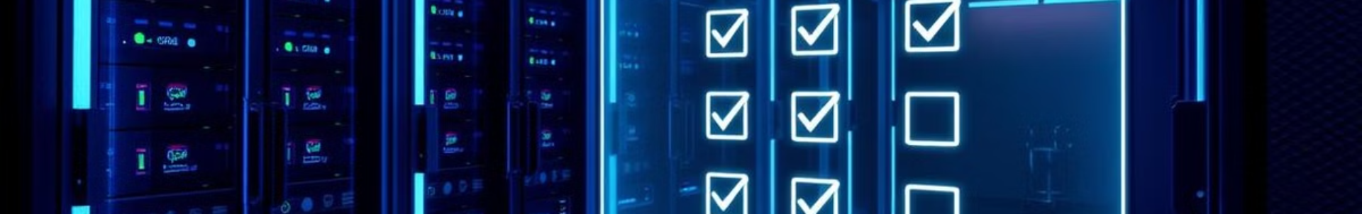
Functional Requirements
Specify Number
1
Allow users to specify the number of passwords to generate at once.
2
Define Lengths
Enable users to define individual lengths for each password, customizing security.
Character Variety
3
Generate passwords that include lowercase letters, uppercase letters, and numbers.
4
Reset Options
Provide options to reset fields and clear outputs, ensuring ease of use.

Slide 8
Code Explanation
Importing Libraries
Function Definitions
User Interface Setup
The code begins by importing necessary libraries: random for generating random numbers and tkinter for creating the GUI.
The core functionality is encapsulated within functions like generate_password, replace_with_number, and replace_with_uppercase_letter.
The Tkinter root window is initialized with a title and dimensions, setting up the GUI.

Slide 9

Testing and Evaluation
Test Case ID
Description
Expected Outcome
TC01
Generate one password
One valid password is displayed
TC02
Generate multiple passwords
Correct number of valid passwords shown
TC03
Input invalid number
Error message displayed
TC04
Set length below minimum
Warning message displayed

Slide 10
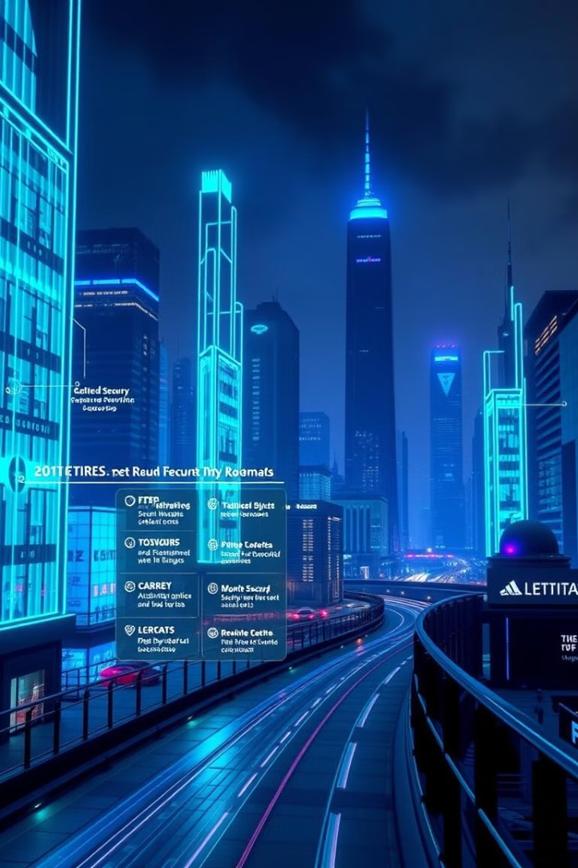
Conclusion and Future Work
The Secure Password Generator successfully meets its objectives by providing users with an easy-to-use interface for generating strong passwords quickly while incorporating essential security features such as character variety.
Future improvements could include adding options for including special characters, implementing a password strength meter, and allowing users to save generated passwords securely within the application.

